Slide 1

Relationship Between Quantity of Ratings and Rating Score on Yelp
Han Huang Mar 2020

Slide 2
Problem Statement
Does knowing the amount of reviews a reviewer has already submitted to Yelp and the number of reviews a business already has on Yelp help predict the likely rating that the reviewer will end up giving for a particular business?

Slide 3
Approach & Process
Performance
Reducing Size of Data Set
EDA
Search for correlations
Seek out user segments
Select target and features
Test hypothesis with different models

Slide 4
Metrics & Assumptions
Key Metrics
Accuracy score
Key Assumptions
There is a correlation between star ratings and frequency of rating that can be measured
That Yelp provided a full data set for Ohio

Slide 5
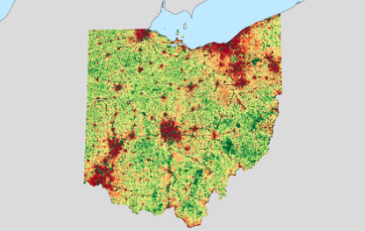
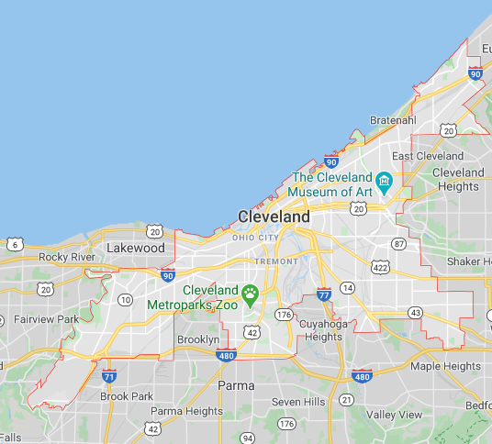
Data Selection
Available Yelp Data
6MM+ reviews
From 11 metros
Selected
Reviews in Ohio
Focused on Cleveland GMA
300K+ reviews selected
https://www.yelp.com/dataset/challenge

Slide 6
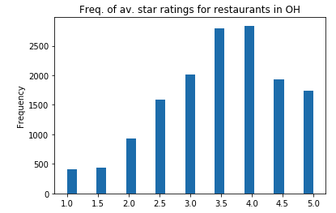
Overview of Business level reviews
Mean star rating of 3.5
Normal Distribution skewed left
92% of businesses have only one location

Slide 7
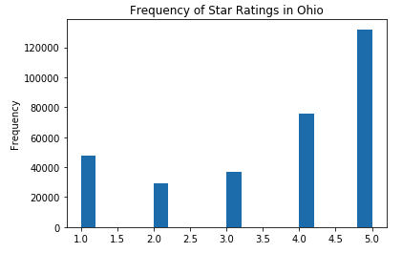
Overview of Individual Reviews
Inverse normal distribution
41% of reviews score a 5 star rating

Slide 8
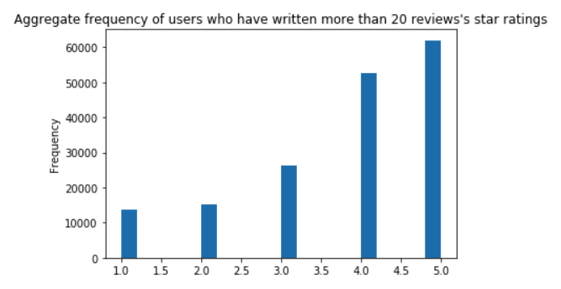
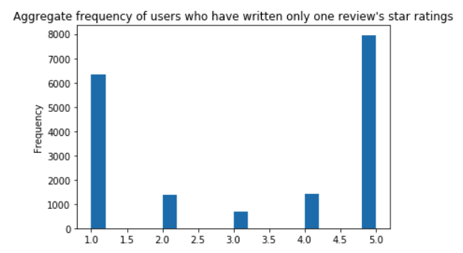
Overview of Reviewers
2.3% of reviewers wrote 53% of all reviews
58% of reviewers have written only one review
92K reviewers in the data set

Slide 9
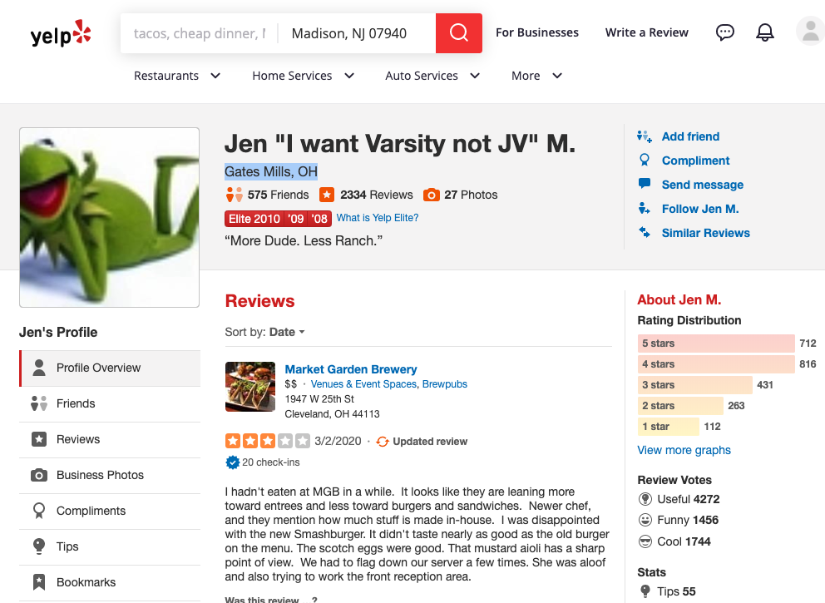
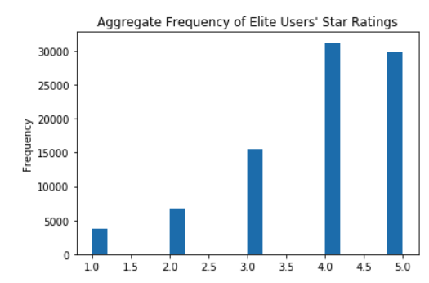
Elite User Profile
Reviews
4s + 5s
“Useful”
Friends

Slide 10
What Drives an “Elite” User to Review
Interests / Passions ?
Satisfaction level?
Self Image?
Social status?
Freebies?
Payment?

Slide 11
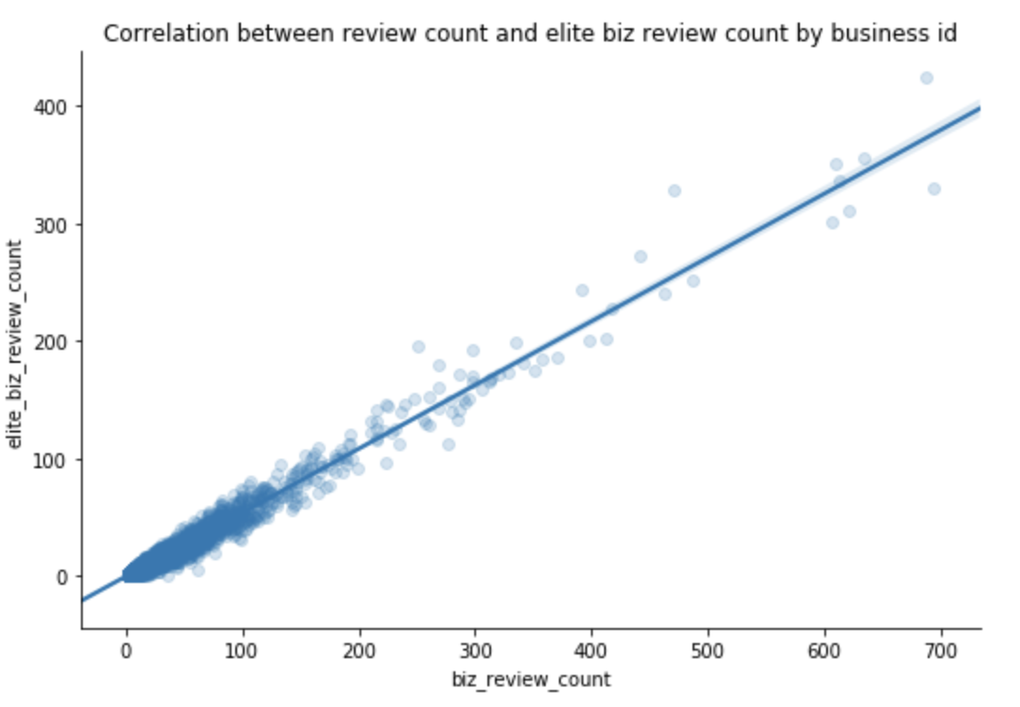
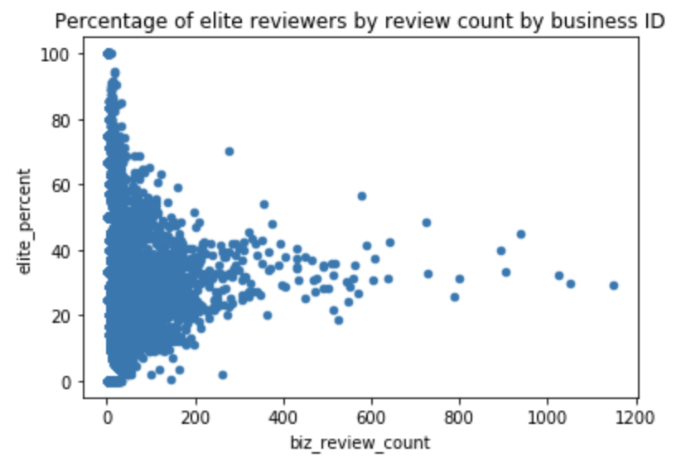
Elite users attracted to the same places

Slide 12
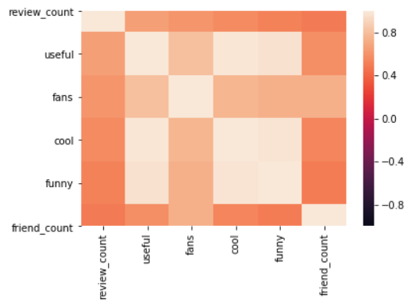
Review Count & Social Correlation

Slide 13
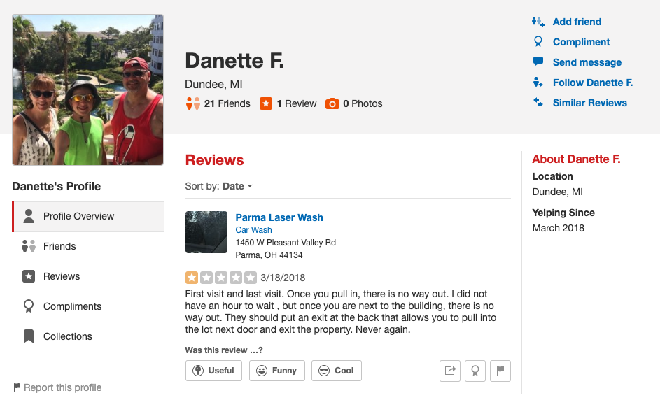
“One Timer” Profile
Reviews
1s
Social
Friends

Slide 14
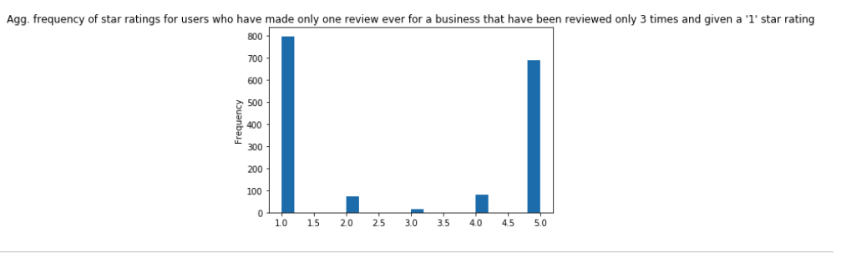
What Drives a “One timer” to Review
Deeply dissatisfied? Very Satisfied?
First step as a budding reviewer?
Fraudulent?

Slide 15
Baseline Accuracy
Sum of 2, 3 & 4 ratings as a % of total reviews
5 and 1 are broken out separately in the target
Baseline accuracy = 44.1%

Slide 16
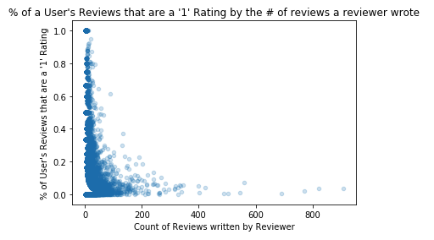
Challenge for beating baseline
There are clear user segments
But there is a lot of noise too

Slide 17
Features and Target
Selected Features
User Review Count
Business Review Count
Target
Review score grouped into three groups:
1 = ‘1’
2 = ’5’
3 = ‘2’, ‘3’ or ‘4’

Slide 18
Data Types Used in Model
Target is categorical
Features selected are continuous

Slide 19
Performance Evaluation
Model | Features | Settings | Test | Test Score | Over / Under Baseline
Logistical Regression | Users & biz counts | 20% training , Scaling | Accuracy | 50.0% | +3.9%
Logistical Regression | Users counts | 20% training , Scaling | Accuracy | 50.5% | +4.4%
KNN | Users & biz counts | 3 neighbors, scaled | Accuracy | 44.5% | + 0.4%
Neural Networks | Users biz, friend count, is_open, lat_lon cluster, elite, totalwords | Dense, 8 nodes, 1 hidden layer: relu, binary crossentropy, 10% of rows used | Not completed

Slide 20
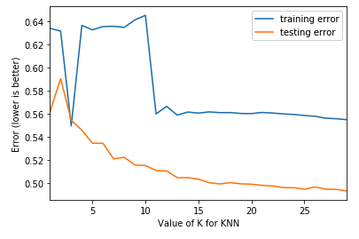
KNN Model Training Testing Error

Slide 21
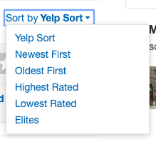
Impact of Findings
Leveraging predictive model has limited aggregate lift…
But high frequency reviewers are more conscious of scoring to a curve…
Yelp already allows users to filter by them…
But maybe Yelp should highlight more in the search choices

Slide 22
Thank you!

Slide 23
Appendix

Slide 24
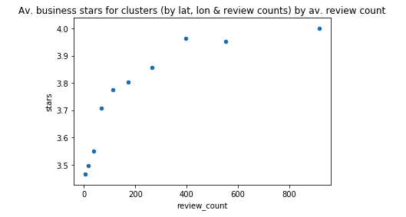
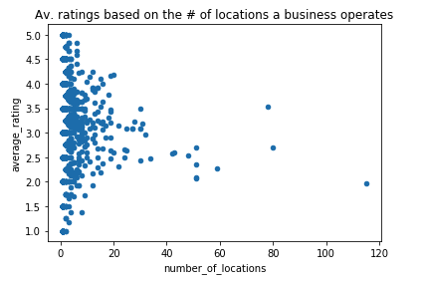
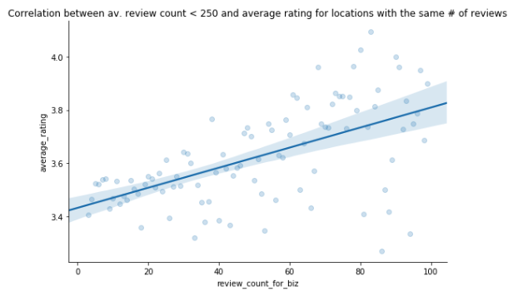
Drivers of Business Aggregate Star Ratings
Some clustering
Relatively weak correlations

